Slide 1



Renewable Ammonia:
Kenya’s Business Case
REPORT SERIES
CLEAN HYDROGEN PROJECTS IN THE GLOBAL SOUTH
Report Launch Event
April 2025
Notes:
Thank you Susana, and welcome on my part as well to the presentation of our report, 'Renewable Ammonia: Kenya’s Business Case.'

Slide 2

Hydrogen opportunity
Notes:
The production of renewable, hydrogen-based ammonia presents a major opportunity for Kenya's socio-economic development. In this report, we explore viable business cases linked to specific locations across the country.

Slide 3
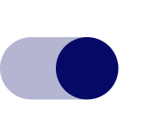
Kenya's hydrogen opportunity
Kenya’s hydrogen strategy
Opportunities
2023 – 2027
Local value creation and economic development.
Increased independence from global fertilizer markets.
Industrial decarbonization across key sectors, including fertilizer production, mining operations, and steel manufacturing.
Enhanced energy infrastructure and improved access to energy.
Domestic market development
Renewable fertilizer production target: 100,000 tons per year
2028 – 2032
Domestic market growth
Renewable fertilizer production target: >300,000 tons per year
2032 and beyond
Kenya as a front runner in the African hydrogen economy
Domestic and export market growth
Notes:
Key development opportunities associated with hydrogen projects include…
In a parallel piece of research, we conducted a clustering analysis of African countries to analyze their socio-economic potential to develop a hydrogen sector. Kenya emerged as a front runner in this analysis, being … (report will be launched in a couple of weeks)
Kenya launched a hydrogen strategy in 2023 to support this development: Strategic emphasis on domestic renewable fertilizer production with production targets of 100 ktons by 2027 and over 300 ktons by 2032.

Slide 4
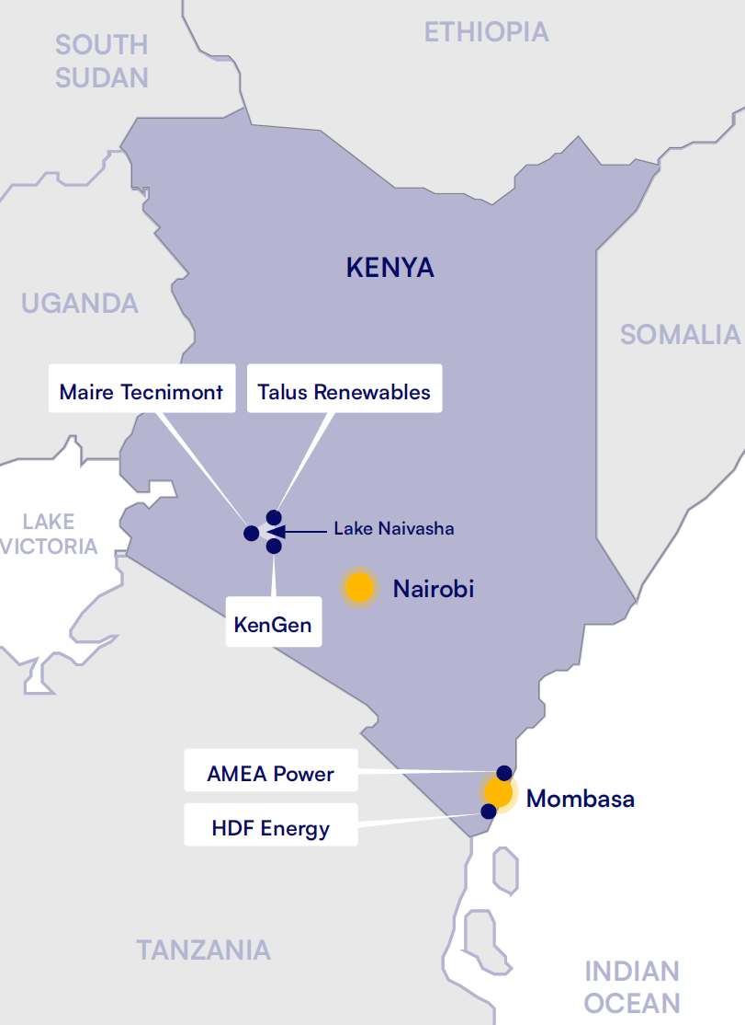
Building viable business cases for renewable hydrogen in Kenya
Current hydrogen projects in Kenya
Advancing Kenya's hydrogen economy
Current projects focus on renewable fertilizer production.
4/5 projects are still in the feasibility stage.
Talus Renewables is the only operational project, producing renewable fertilizer at a small scale.
Planned projects are centered around Lake Naivasha and Mombasa.
What do viable business cases for renewable hydrogen in Kenya look like?
Where should new renewable hydrogen projects be located?
What are success factors for new hydrogen projects?
Notes:
Currently planned hydrogen projects are in line with this strategy, focusing on renewable ammonia production.
Project location
However: 4/5 projects are still in feasibility stage.
In this report we ask: Where are suitable locations for renewable-hydrogen based ammonia production in Kenya and under which circumstances can these projects make viable business models?

Slide 5
Our research
Notes:
Let me present our research methodology to you.

Slide 6
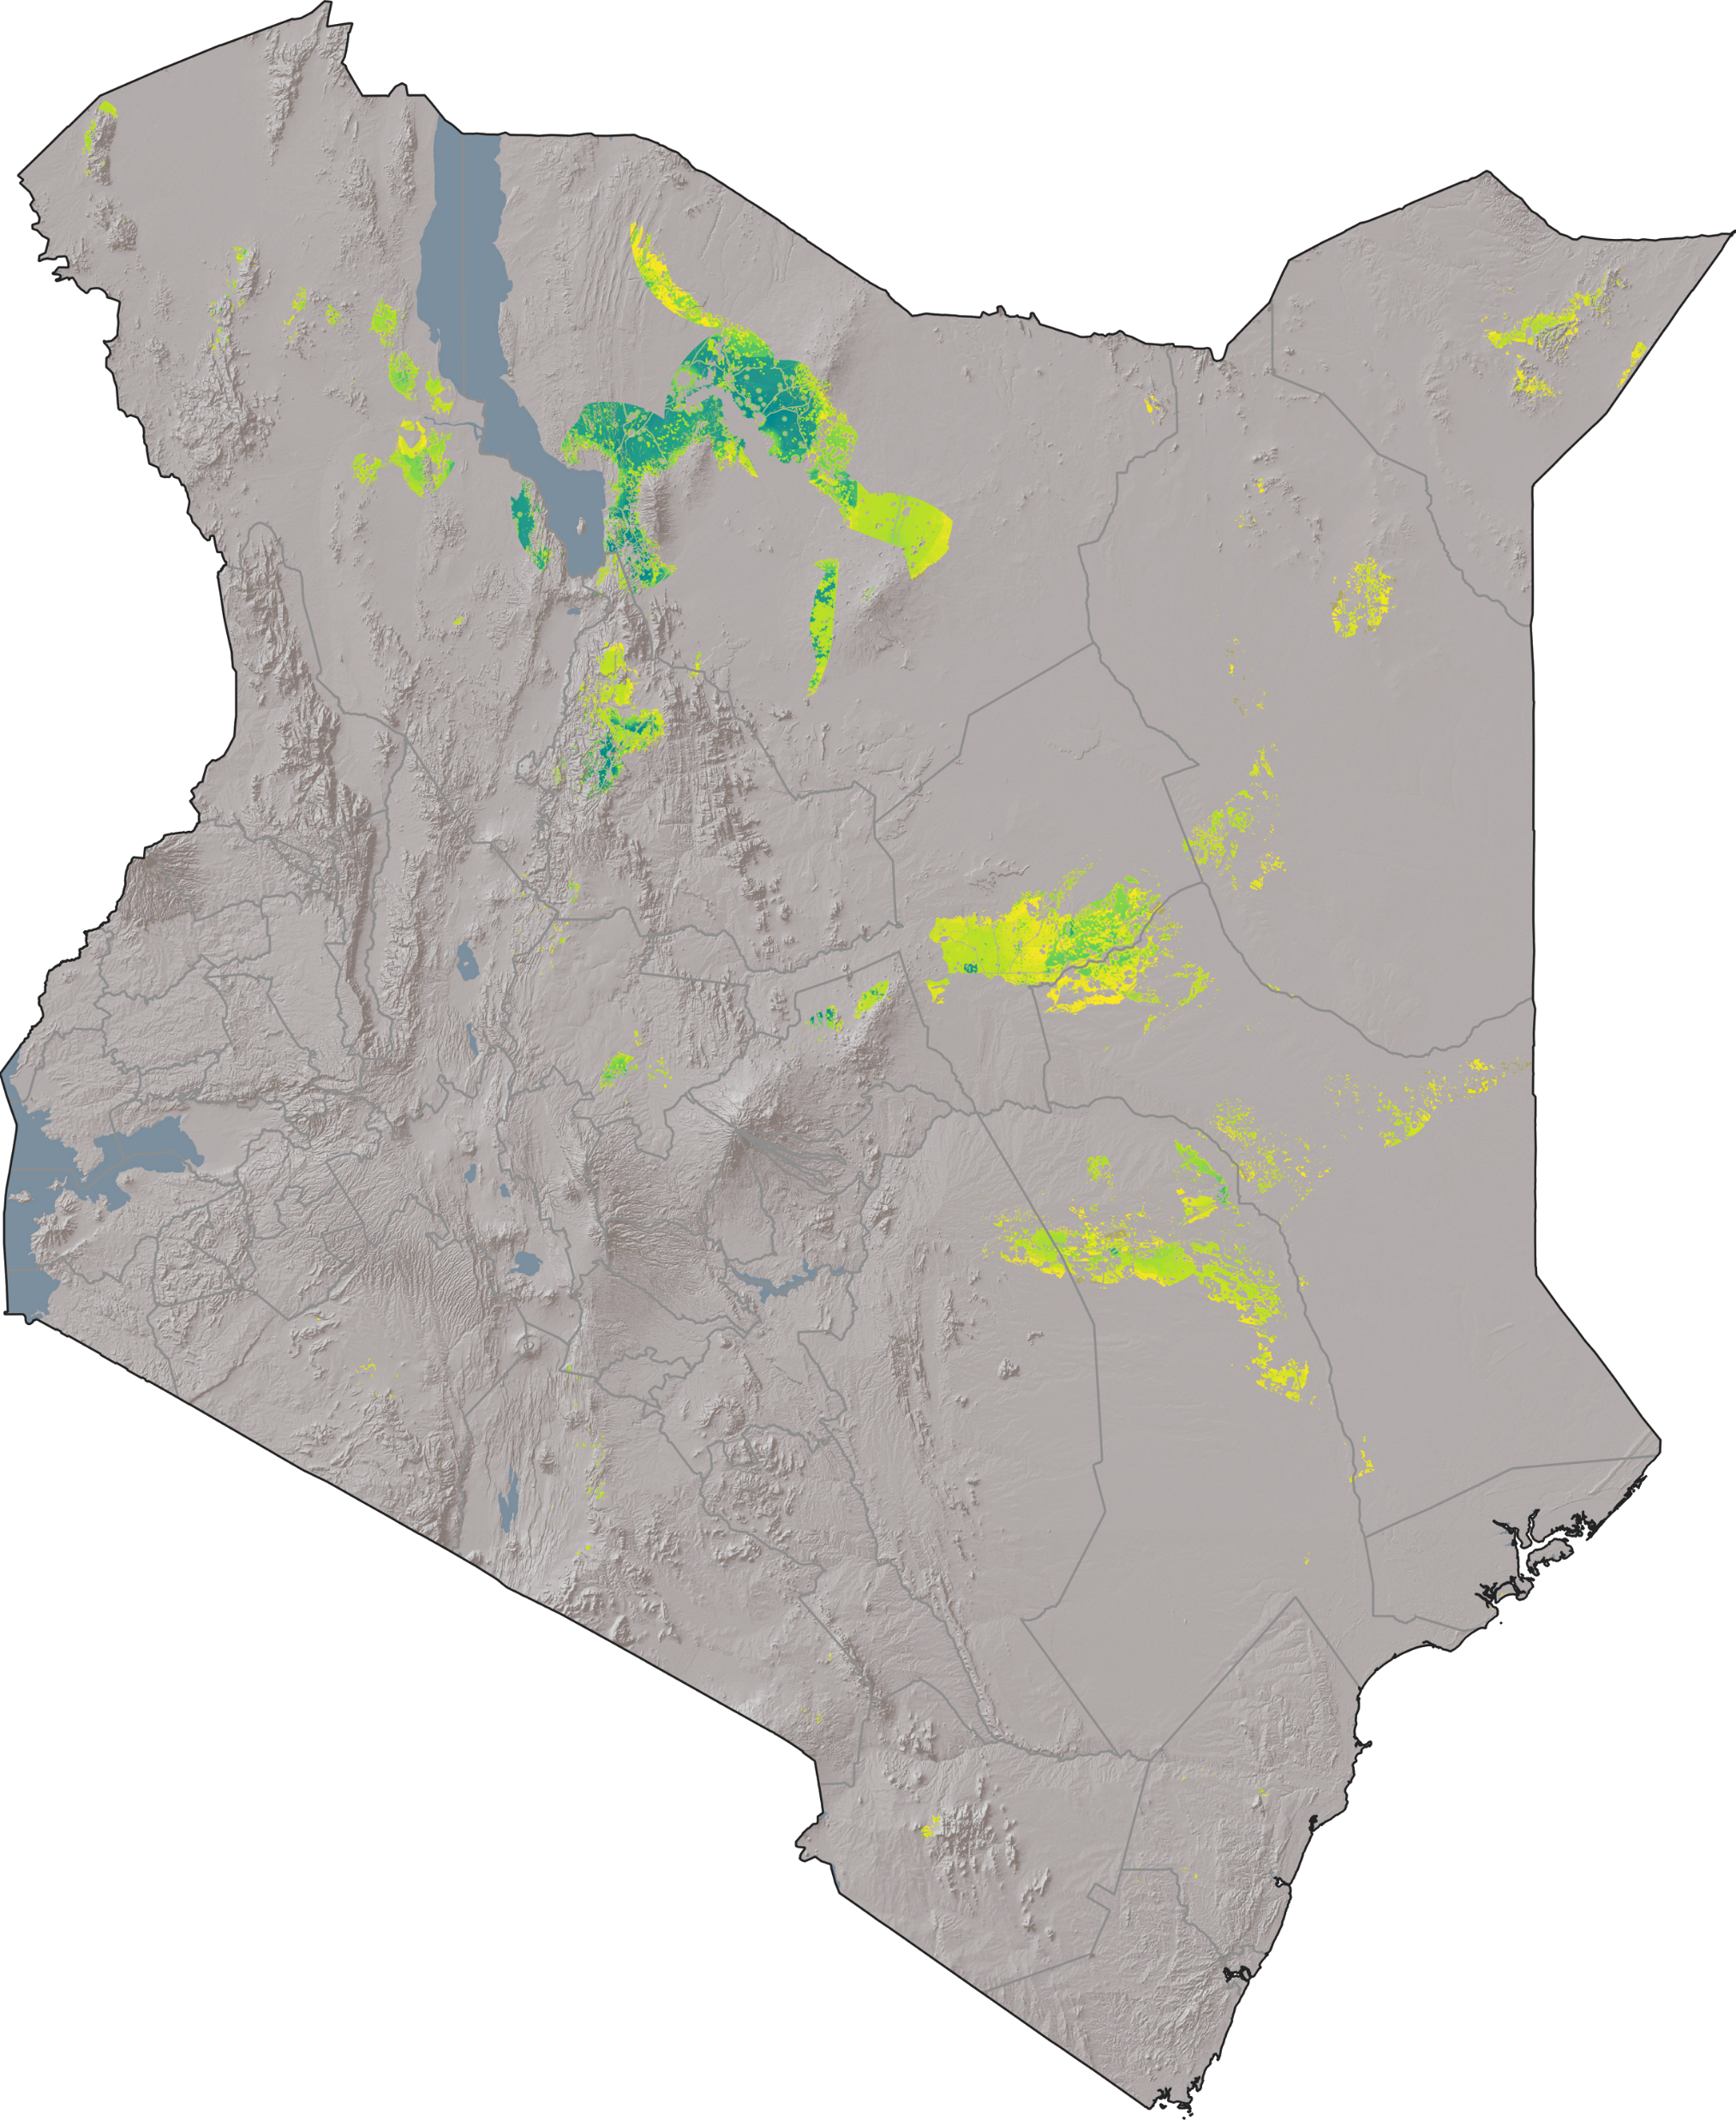
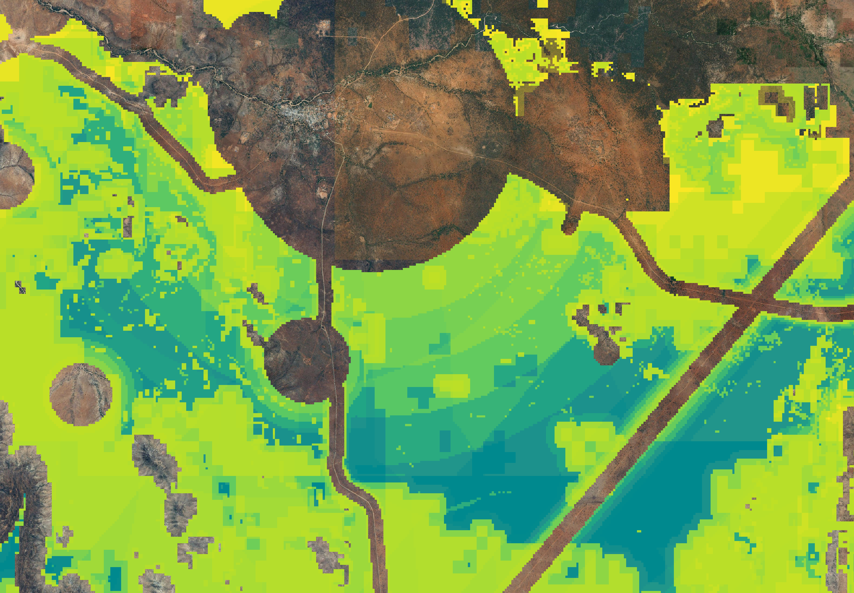









Methodology
Spatial resolution: 50x50m
GIS analysis to identify
suitable locations
Kenyan stakeholder workshop
to identify favorable locations
Solar and wind
Site optimization and financial analysis
to simulate viable business cases
Grid expansion
Battery and hydrogen
storage
Ammonia
production
Identify conditions for economically
viable hydrogen projects
Electrolysis
GIS analysis: https://maps.iee.fraunhofer.de/ptx-kenya-atlas/
Notes:
What does it take to produce renewable ammonia? Bottom-left: visualization
First step: GIS-based assessment of the renewable energy potential in Kenya, to identify suitable locations for project development.
Subsequently, online workshop with local stakeholders.
Then, optimized technical configuration & conducted financial analysis.
I’ll now hand over to Benedikt from the Fraunhofer IEE, who will delve into the findings from the GIS-based renewable energy potential analysis, using an interactive visualization of the results.

Slide 7
RE potential open-source webtool

Slide 8
Analysis
Notes:
Thank you Benedikt, for these insights into the renewable energy potential analysis. Let’s start into the analysis of the identified locations.

Slide 9
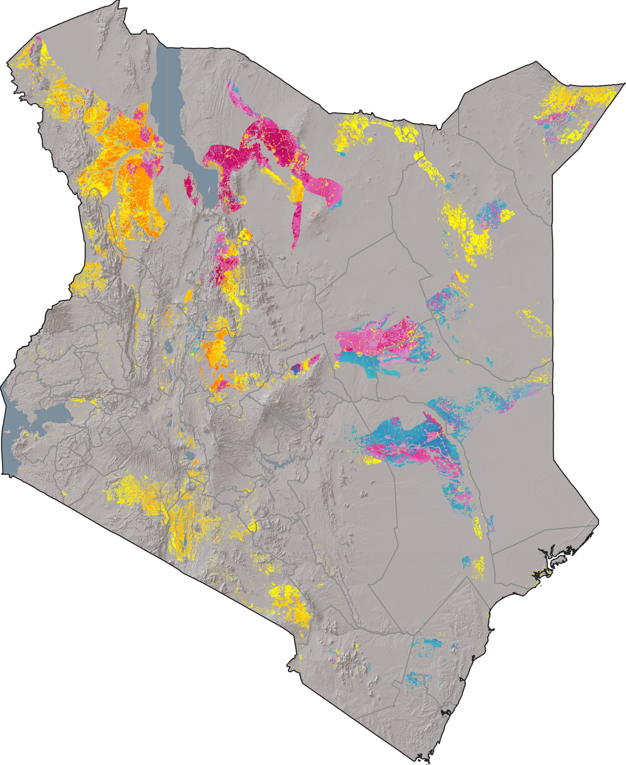



Four Kenyan regions highly suitable for anchoring renewable ammonia projects
Turkana
Central
Characteristics of selected regions
Sufficient renewable energy potential to operate a 500 MW electrolyzer
Sufficient water availability from open-water sources
Non-conflicting land use
Transport and electric infrastructure in proximity
Offtake opportunities for renewable hydrogen-based products
Turkana
South
Kisumu
Characteristics of excluded regions
Mombasa
Insufficient renewable energy potential or water availability
Land-use conflicts
Remote location with no infrastructure or offtake opportunities for renewable hydrogen-based products
Limited
Suitable
Notes:
As Benedikt presented, we have selected four suitable locations for renewable hydrogen-based ammonia production.
All these locations combine: a) sufficient renewable energy potential to operate a 500 MW electrolyzer, b) sufficient water availability, c) non-nonflicting land-use, d) transport and electric infrastructure in proximity, which can be utilized and extended, as well as e) offtake opportunities for renewable hydrogen-based products.
We begin our analysis at Lake Turkana.

Slide 10
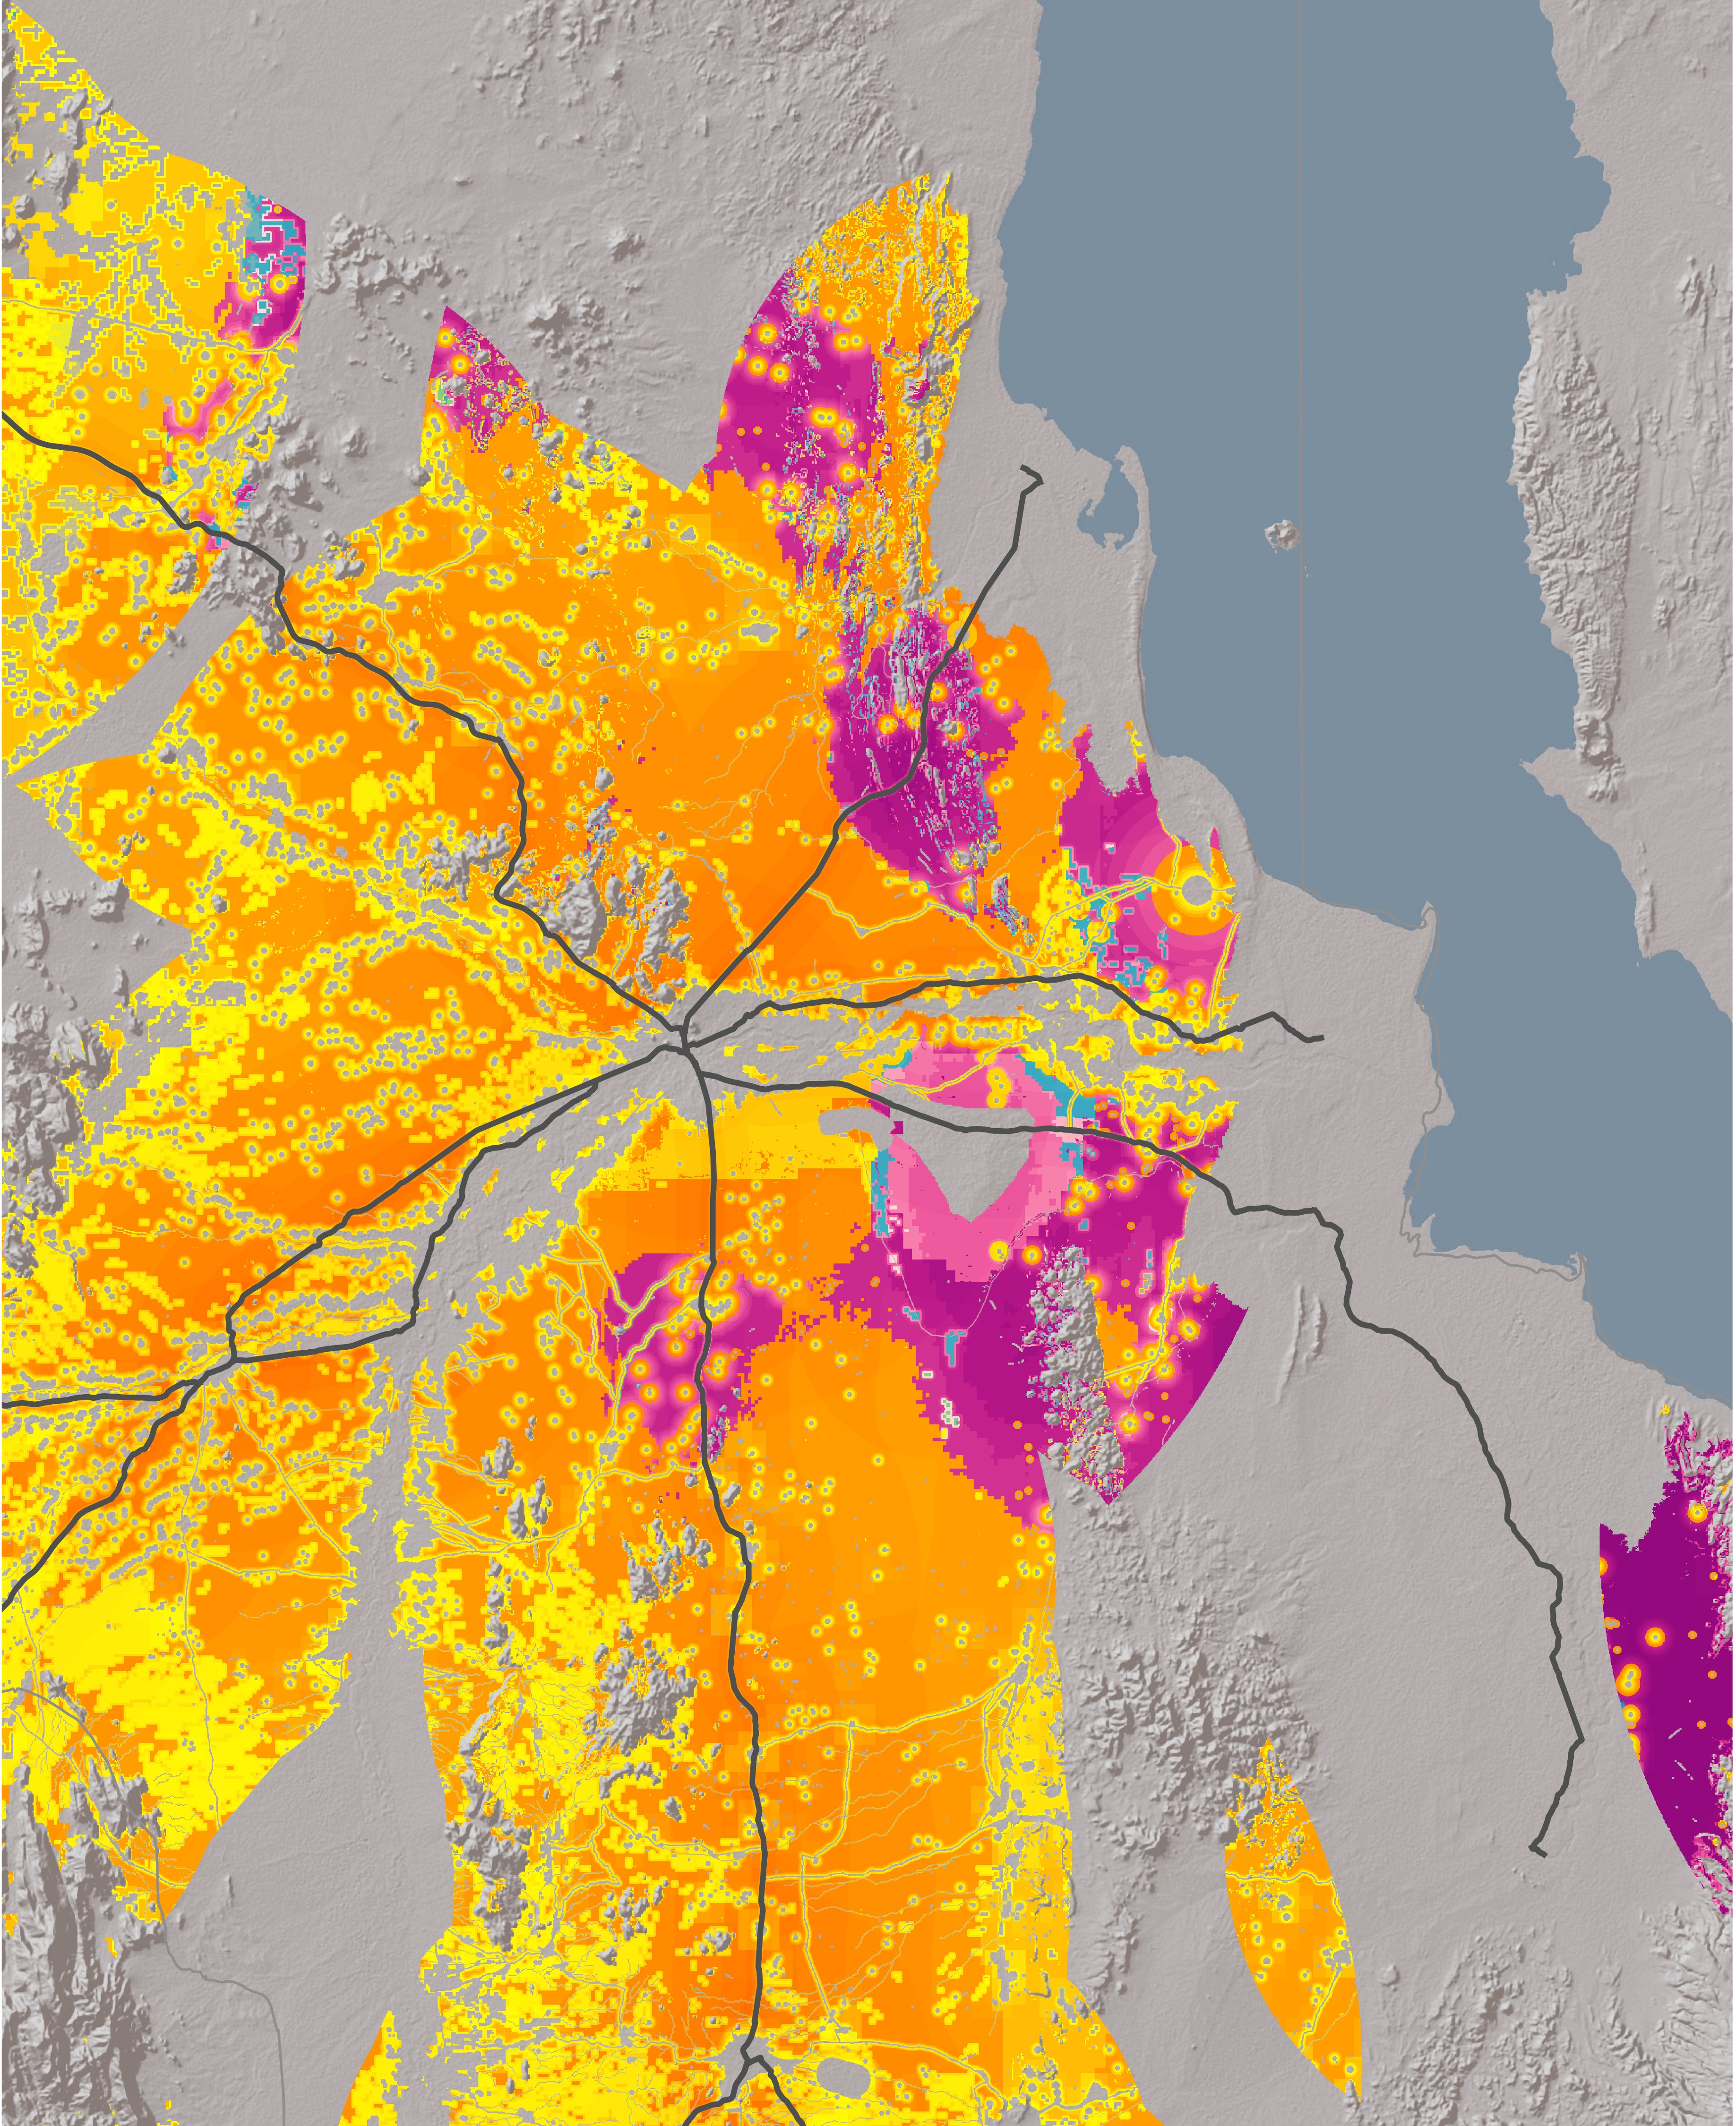







Turkana Central
Limited
Suitable
^{Ethiopia}
^{100km}
Major road
Located in northern Kenya, to the western side of Lake Turkana.
Extensive potential for solar and hybrid (wind and solar) energy around the city of Lodwar.
The region itself does not have significant offtake potential for renewable hydrogen-based goods such as ammonia or fertilizer.
Proximity to the city of Lodwar provides access to transport infrastructure and everyday goods for workers.
Electric grid infrastructure is accessible to the south of Lake Turkana in 170km distance, offering sufficient capacity to supply electrolyzers of up to 100 MW.
Sufficient water for hydrogen production is available through Lake Turkana or the Turkwell River.
^{Lake Turkana Wind Power (LTWP)}
^{310 MW}
^{Uganda}
^{85km}
^{Nairobi}
^{450km}
25 km
Notes:
Location & renewable energy potential.
Offtake: not significant, further offtake opportunities in the South.
Electric infrastructure: transmission line South of Lake Turkana, capable of supplying a 100MW electrolyzer
City of Lodwar: Transport infrastructure and everyday goods for workers.

Slide 11
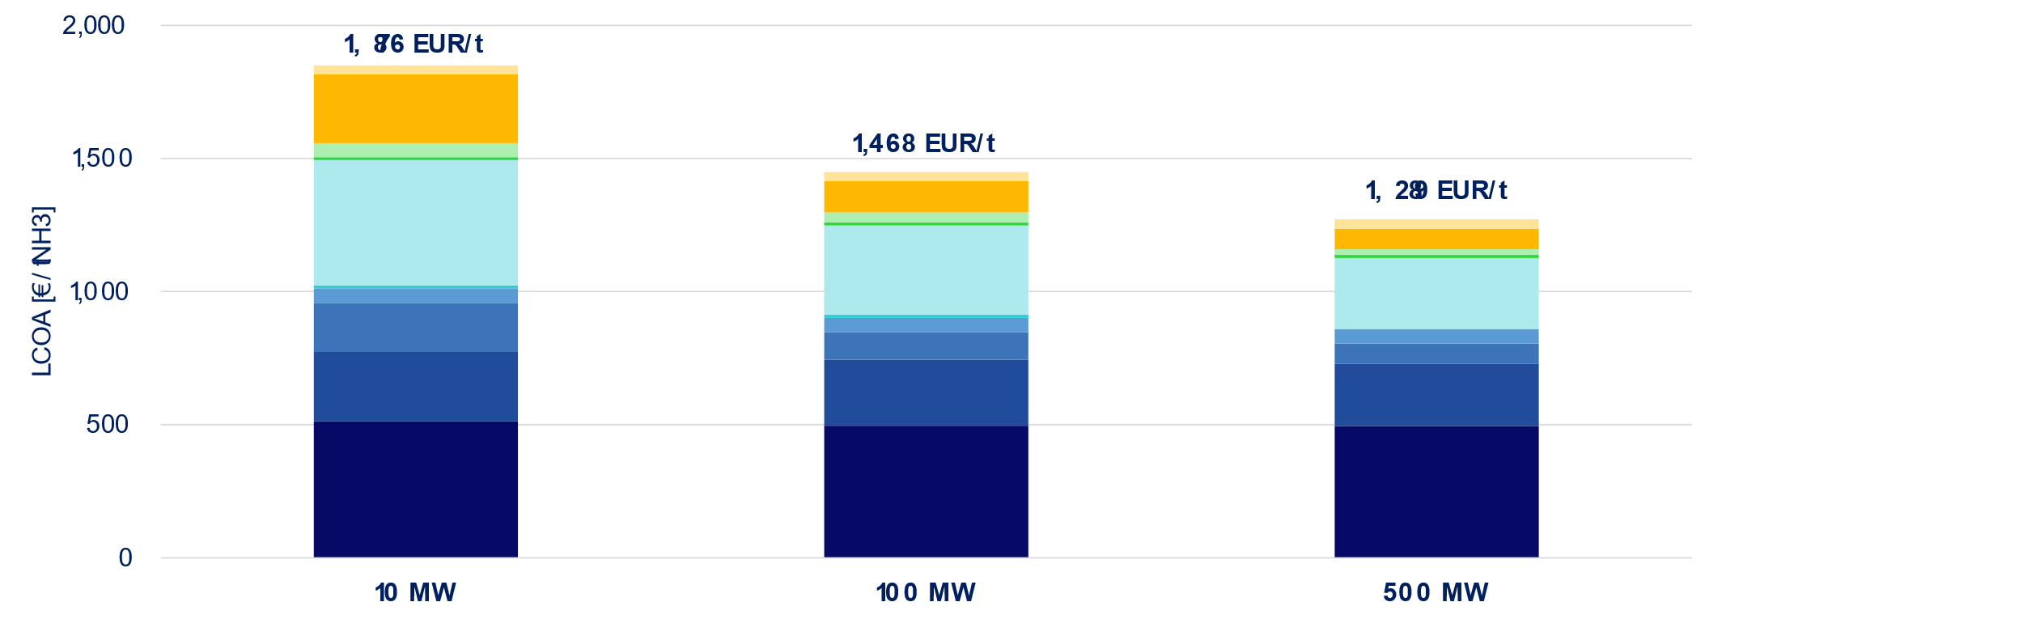
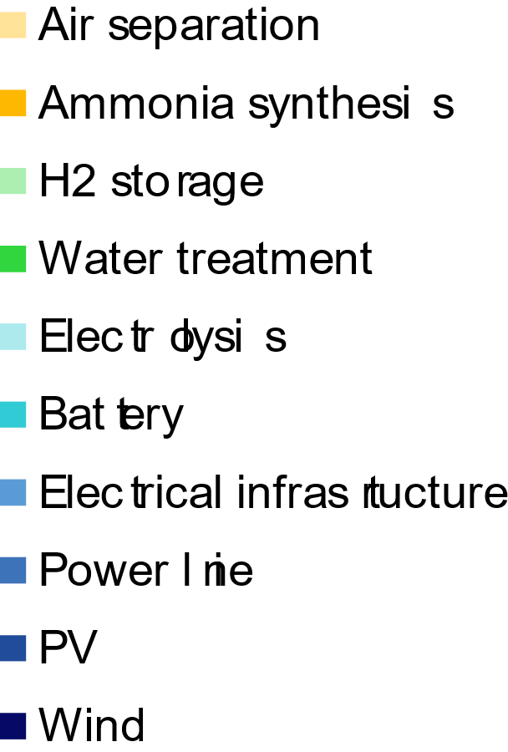
Turkana Central
Total investment costs
EUR 66 Mio.
EUR 489 Mio.
EUR 2,107 Mio.
Annual ammonia production
6,500 t-NH3/year
62,800 t-NH3/year
303,000 t-NH3/year
Notes:
Different project sizes: 10MW, 100MW, and 500MW.
Total investment costs range: EUR 66 Mio. to EUR 2.1 Billion
Annual production ranges: 6,500 t-NH3 / year (10 MW) to ca. 300,000 t-NH3 / year (500 MW).
LCOA ranges: 1,876 EUR/t (10 MW) to 1,289 EUR/t (500 MW) → Scaling to 500MW leads to a cost decrease of ca. 30%
RE costs make up: 40% (10MW) to 60% (500MW)

Slide 12
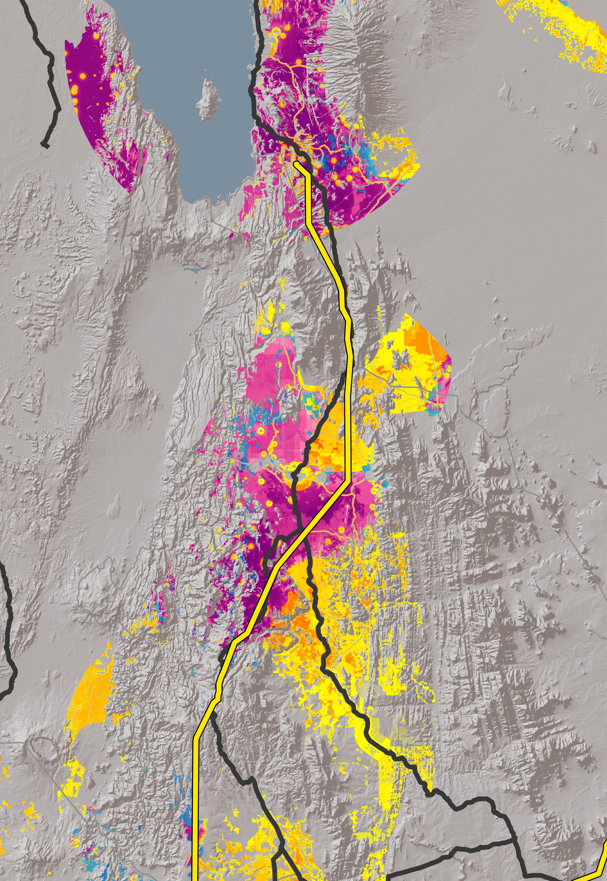
Turkana South
^{Lake Turkana Wind Power (LTWP)}
^{310 MW}
Located in northern Kenya, to the south of Lake Turkana and within the geothermally active Rift Valley.
Extensive potential for solar, wind and hybrid (wind and solar) energy. Presumably also geothermal energy potential, which would have to be confirmed by on-site test drills.
The region itself does not have significant offtake potential for renewable hydrogen-based goods such as ammonia or fertilizer.
Major roads run through the identified region, providing the required transport infrastructure.
Connection to the national electricity grid could be enabled via a transmission line running through the region, offering sufficient capacity to supply electrolyzers of up to 100 MW.
Sufficient water for hydrogen production is available through Lake Turkana.
Limited
Suitable
50 km
Major road
High-voltage line
^{Nairobi}
^{350km}
Notes:
Location and renewable energy potential.
Offtake: not significant, further offtake opportunities in the South.
Electric infrastructure: transmission line South of Lake Turkana, capable of supplying a 100MW electrolyzer (same as for Lake Central)
Infrastructure: Major roads run through the potential region, providing the required transport infrastructure.

Slide 13
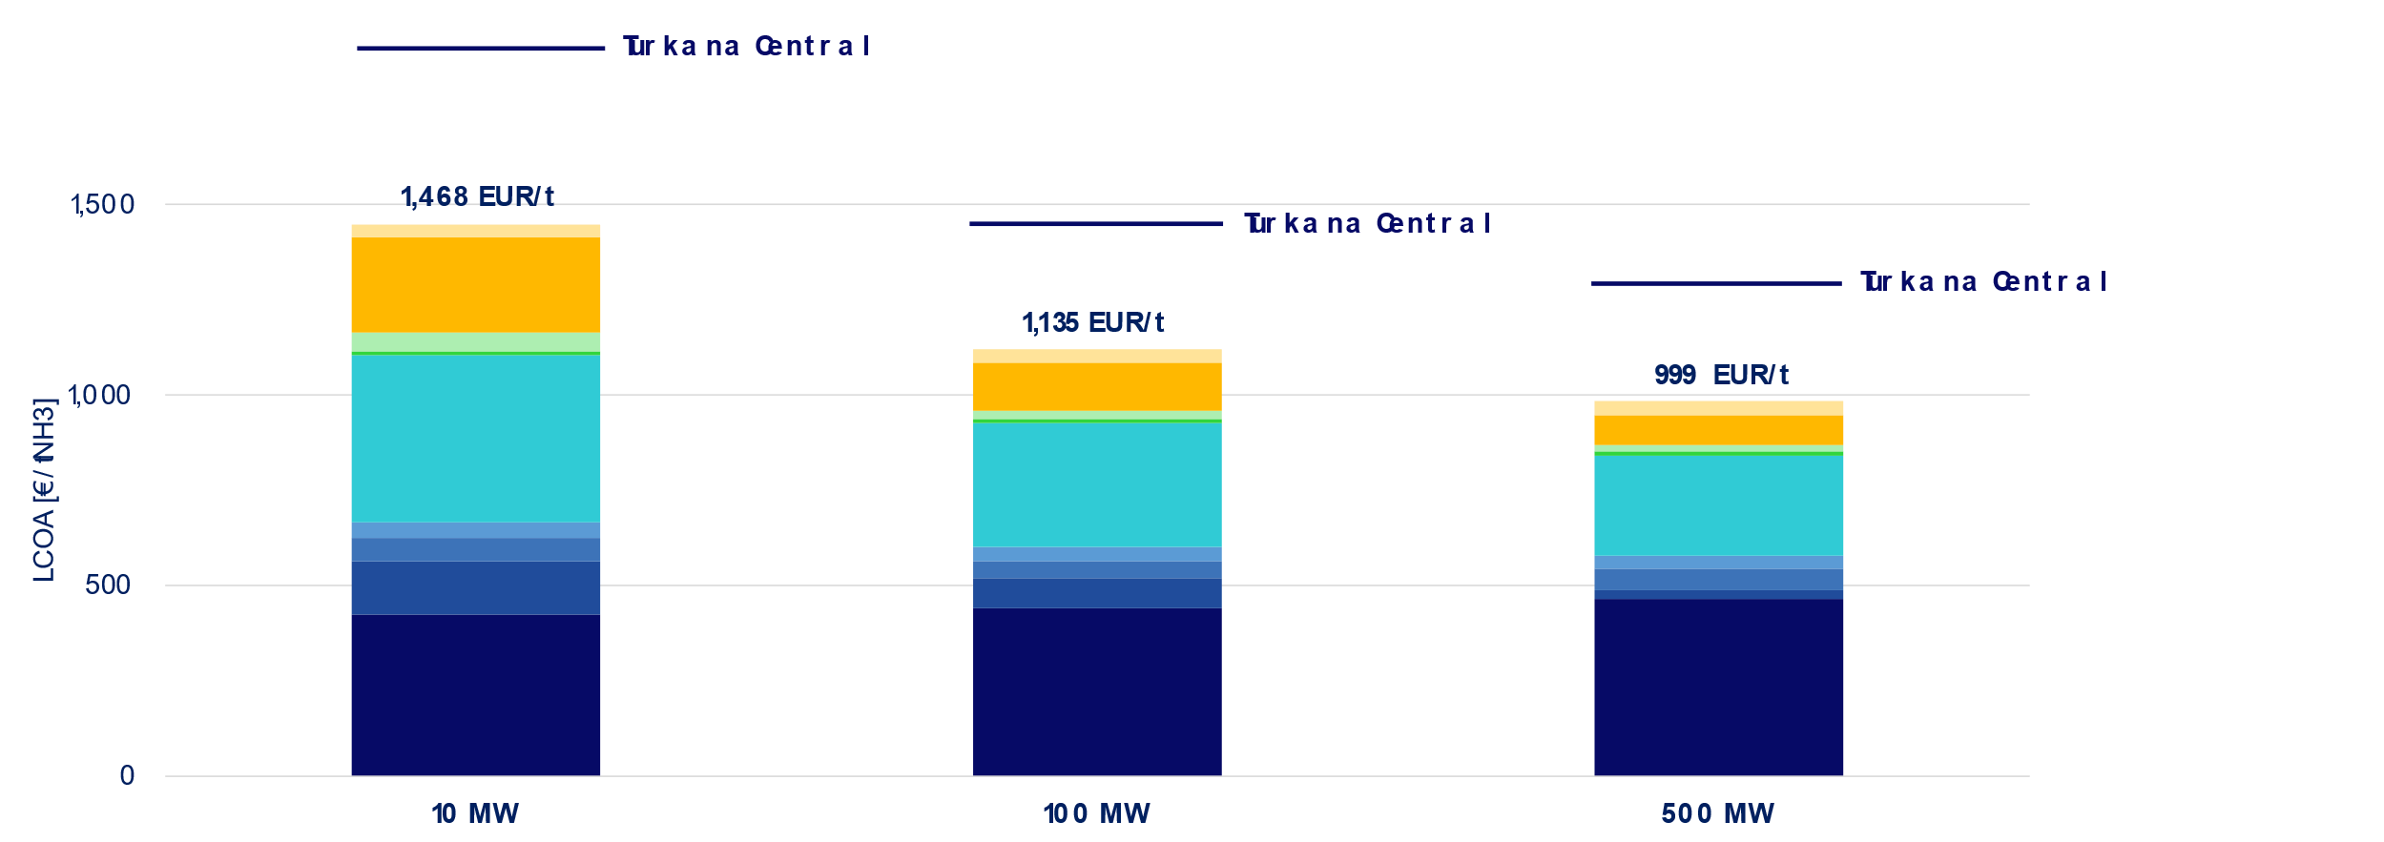
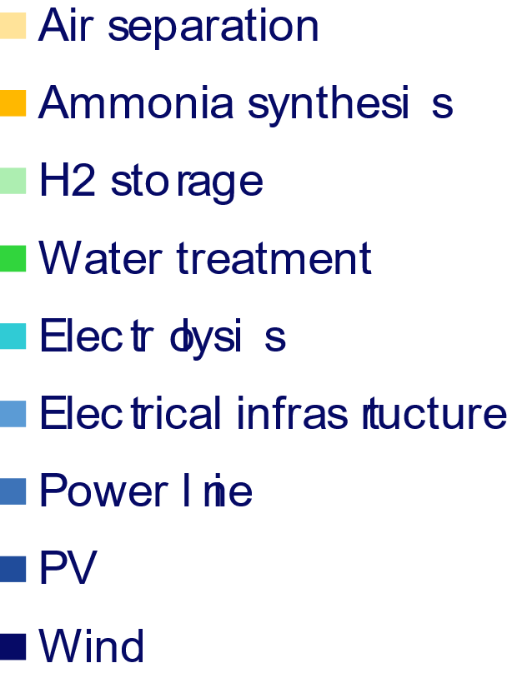
Turkana South
Total investment costs
EUR 54 Mio.
EUR 381 Mio.
EUR 1,630 Mio.
Annual ammonia production
7,100 t-NH3/year
65,500 t-NH3/year
310,500 t-NH3/year
Notes:
Total investment costs range: EUR 54 Mio. to EUR 1.6 Billion (lower than Turkana Central)
Annual production ranges: 7,100 t-NH3 / year (10 MW) to ca. 311,000 t-NH3 / year → Higher than Turkana Central
LCOA is lower than in Turkana Central! 1,468 EUR/t (10 MW) to 999 EUR/t (500 MW) → Lowest LCOA across all regions due to best RE potential!

Slide 14
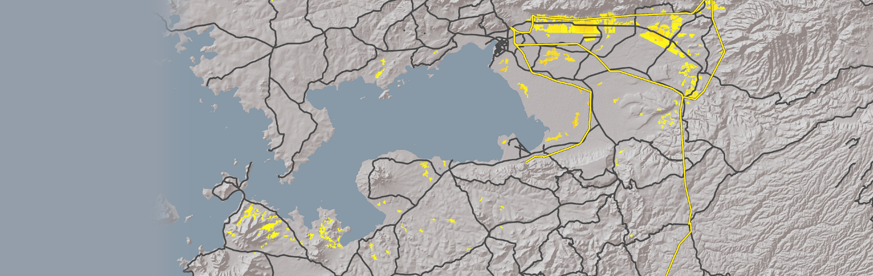



Kisumu
Although an electric grid infrastructure exists in the region, its capacity and reliability is too low to facilitate reliable transmission of renewable electricity to electrolyzers.
The region bears significant potential for the offtake of renewable hydrogen-based ammonia and fertilizer to local industries and agriculture. Furthermore, export opportunities exist through Lake Victoria to neighboring countries.
Located in western Kenya, at the shoreline of Lake Victoria.
Extensive potential for solar energy only.
Proximity to Kenya’s 3rd largest city provides access to transport infrastructure and everyday goods for workers.
Sufficient water for hydrogen production is available through Lake Victoria.
Kopere Solar Power Plant (50 MW)
^{50 km}
^{Alten (44 MW),}
Radiant (40 MW), Eldosol (40 MW)
^{Solar Power Plants}
^{90km}
Limited
Suitable
^{KISIMU}
25 km
^{HOMA}
^{BAY}
Major road
High-voltage line
^{Nairobi}
^{260km}
Notes:
Location and renewable energy potential.
Offtake: Good potential, either through Lake Viktoria or to close-by industries around Kisumu or Nairobi, which is located ca. 260 km to the East.
Infrastructure: Insufficient electric infrastructure to serve the needs of ammonia production projects. However, good transport infrastructure exists.
Water availability

Slide 15
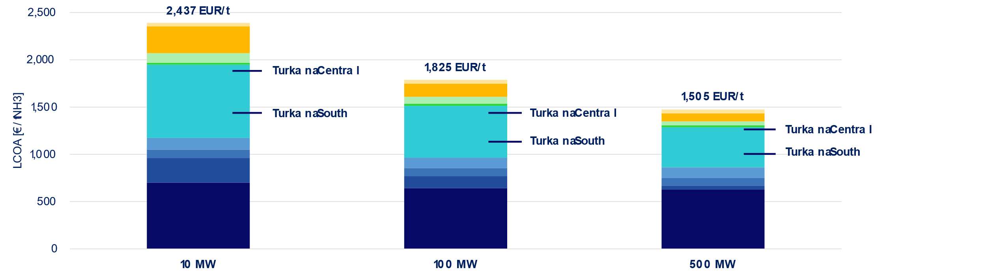
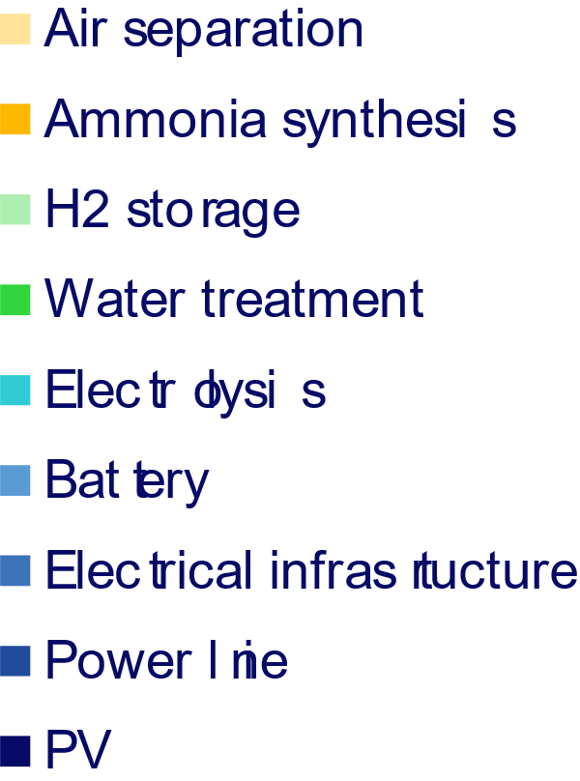
Kisumu
Total investment costs
EUR 47 Mio.
EUR 340 Mio.
EUR 1,357 Mio.
Annual ammonia production
3,400 t-NH3/year
32,400 t-NH3/year
157,900 t-NH3/year
Notes:
Total investment costs range: EUR 47 Mio. to EUR 1.4 Billion
Annual production ranges: 3,400 t-NH3 / year (10 MW) to ca. 160,000 t-NH3 / year (lowest across all regions)
2,437 EUR/t (10 MW) to 1,505 EUR/t (500 MW) → LCOA is highest across all regions!

Slide 16
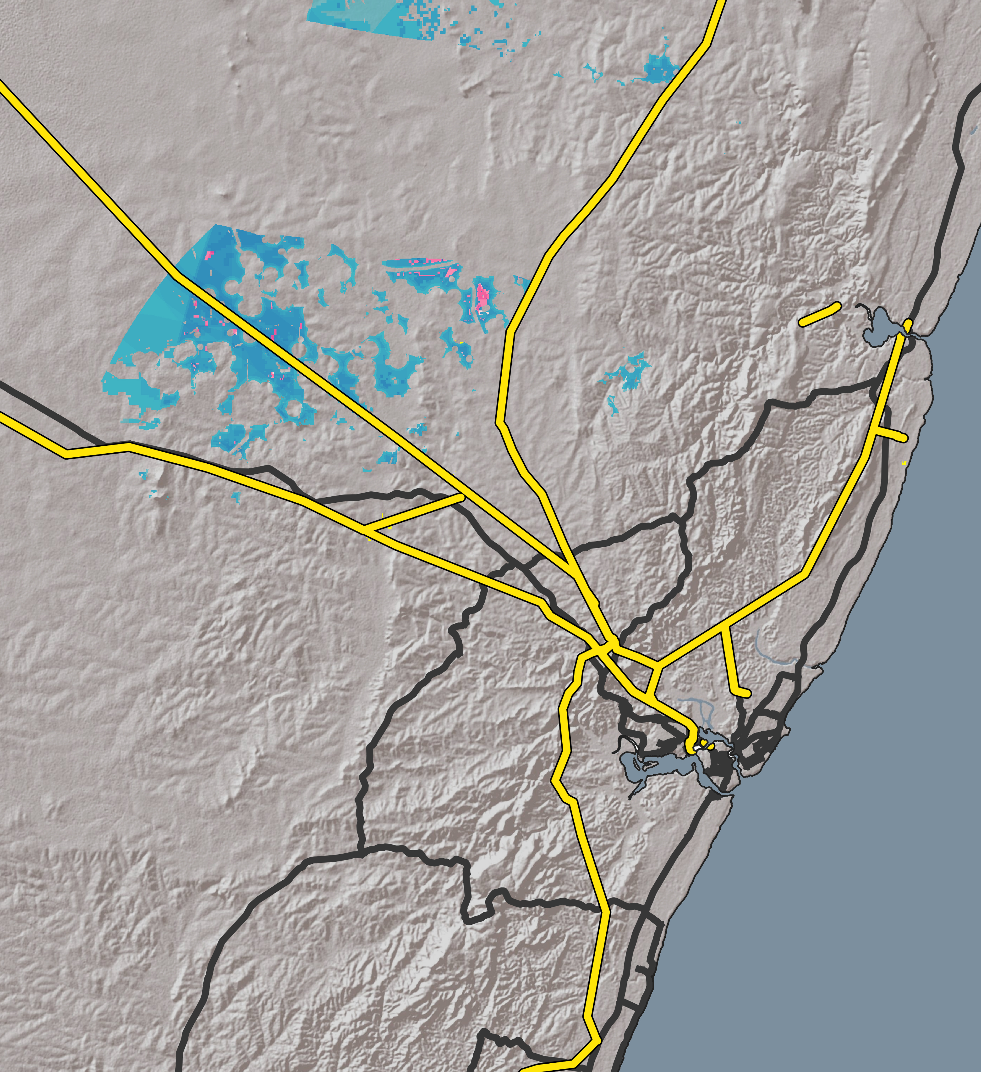
Mombasa
Malindi Solar Power Plant (52 MW)
Located in southeastern Kenya, along the country’s Indian Ocean coast.
Extensive potential for wind energy and – in a few locations – for hybrid renewable energy (wind and solar).
The region bears significant potential for the offtake of renewable hydrogen-based ammonia and fertilizer to local industries and agriculture. Furthermore, export opportunities to international markets exist through the port of Mombasa.
Proximity to Kenya’s 2nd largest city provides access to transport infrastructure and everyday goods for workers.
The existing electric grid offers sufficient capacity to supply electrolyzers of up to 500 MW.
Sufficient water for hydrogen production is available through desalination of Indian Ocean sea water.
^{Nairobi}
^{440km}
^{Kilifi Wind Farm}
^{(36 MW)}
Limited
Suitable
^{MOMBASA}
25 km
Major road
High-voltage line
Notes:
Location and renewable energy potential.
Offtake: Good offtake opportunities, through the port of Mombasa or to close-by domestic industries.
Electric infrastructure: Capable of supplying electricity to large-scale electrolysis plants. Significant advantage!
Proximity to the urban area of Mombasa (infra & workers).
Water is available through potential desalination of water from the Indian ocean.

Slide 17
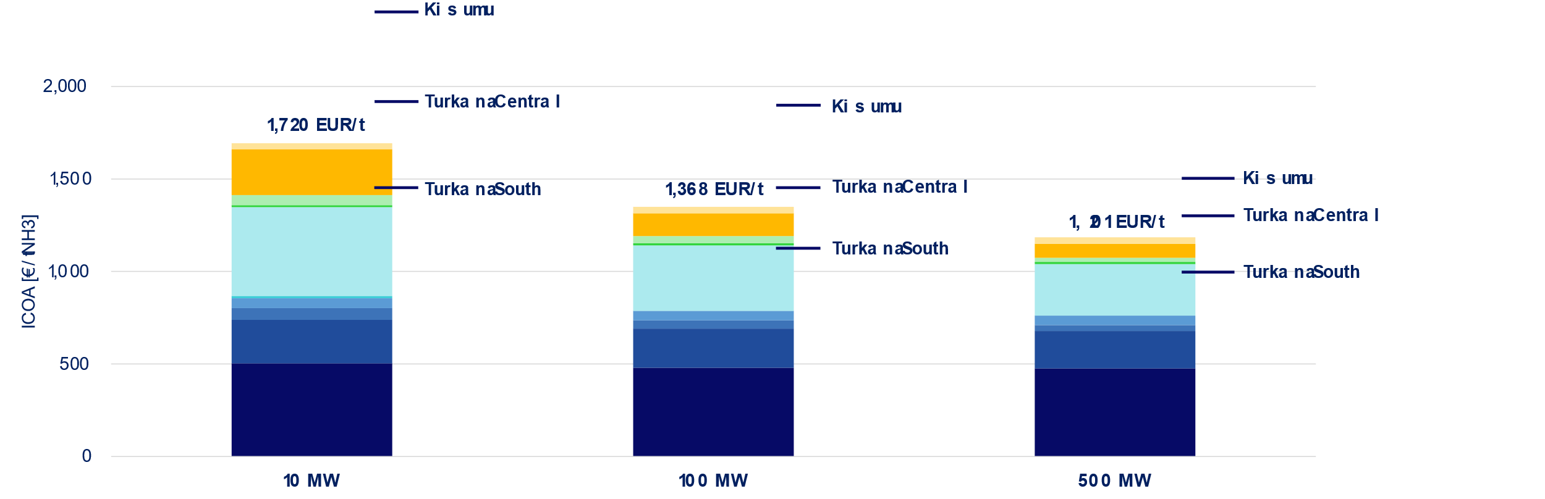
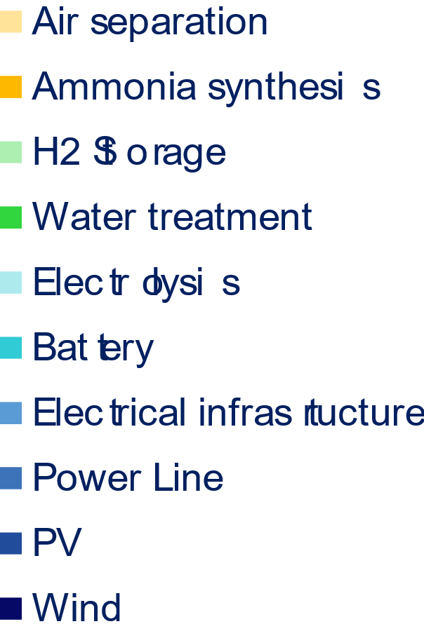
Mombasa
Total investment costs
EUR 58 Mio.
EUR 430 Mio.
EUR 1,813 Mio.
Annual ammonia production
6,400 t-NH3/year
60,200 t-NH3/year
291,300 t-NH3/year
Notes:
Total investment costs range: EUR 58 Mio. to EUR 1.8 Billion
Annual production ranges: 6,400 t-NH3 / year (10 MW) to ca. 290,000 t-NH3 / year
LCOA ranges: 1,720 EUR/t (10 MW) to 1,201 EUR/t (500 MW) → 2nd lowest across all regions
Together with extensive existing electric and transport infrastructure: One of the most suitable regions!
HOWEVER: None of the simulated locations is cost-competitive with current market prices for conventional ammonia! (~400-500 €/t-NH3)
THEREFORE: We are looking at the production of ammonia-based fertilizer as a value-added product to capture this remaining green premium.

Slide 18
Domestic fertilizer market offtake opportunities
Domestic retail fertilizer prices in Kenya significantly exceed global market levels.
During the global energy crisis in 2022, domestic fertilizer prices rose by 20 – 60% compared to preceding and subsequent years.
The estimated production cost of renewable fertilizers – based on locally produced hydrogen – is lower than the domestic retail prices recorded in 2022 across all fertilizer types.
Renewable hydrogen-based fertilizers also demonstrate potential to undercut recent retail prices (as of 2024) for DAP, NPK, and CAN.
2022
Max
2022
2022
2024
2022
2024
Max
Min
Min
2024
Max
Min
2024
Max
Min
Renewable hydrogen-based fertilizers have the potential to be cost-competitive in Kenya’s domestic market, offering a more stable and secure supply at reduced and less volatile prices.
DAP
NPK
Urea
CAN
Notes:
Domestic retail fertilizer prices in Kenya significantly exceed global market levels.
Furthermore, prices are volatile and dependent on global market dynamics. Rise during the energy crisis in 2022 by 20-60%!
Domestic renewable, ammonia-based fertilizer production could stabilize these price fluctuations AND undercut average fertilizer prices.
In turn, this leads to increased price stability at a lower cost for regional consumers, while simultaneously offering a viable business case for renewable ammonia projects in Kenya!

Slide 19
Recommendations

Slide 20




Recommendations
Locations
LCOA
[EUR/ton-NH2]
Mombasa and Turkana South and most favorable, combining potential for low-cost hydrogen production with infrastructure availability and offtake opportunities.
Turkana
Central
1,289-1,876
Fertilizer opportunity
999-1,468
Turkana
South
Renewable hydrogen-based fertilizers have the potential to be cost-competitive in Kenya’s domestic market.
Kisumu
Financial support instruments
1,505-2,437
Renewable ammonia projects need to address green premium and long-term offtake certainty, while renewable fertilizer projects seek to mitigate market price risks.
Enablers
Mombasa
1,201-1,720
High cost of capital and lack of infrastructure constitute key project development barriers.
Notes:
Most-suitable locations: Mombasa and Turkana South
I want to emphasize the opportunity that lies in the domestic fertilizer market: a) It can absorb green premium of ammonia production; b) renewable fertilizer would undercut current market prices, offer increased price stability.
Financial support: a) green premium + long-term offtake for ammonia; b) market price risks for fertilizer
Enablers: a) decrease of the cost-of-capital; b) improvement of infrastructure

Slide 21

Julian Reul
Program Lead Research
T: +49 40 36197500
E: julian.reul@h2-global.org
www.h2-global.org
H2Global library
Copyright ©2025 H2Global Stiftung. All rights reserved.
Disclaimer: This publication is for informational purposes only and does not constitute any warranty, guarantee, or liability for H2Global Stiftung, its subsidiaries, or affiliates.
April 2025

